Slide 1

INTERGRANULAR CORROSION TEST OF SS316L FABRICATED BY POWDER BED FUSION
BY
BALAJI R (211419114048)
BHARATH KUMAR K (211419114055)
ABU FARAS J (211419114009)
Final Year Undergraduates
Mechanical Engineering
Supervisor
Dr. M. PUVIYARASAN, M.E., Ph.D.,
Professor
Department of Mechanical Engineering
Panimalar Engineering College
Chennai – 600123.

Slide 2
PRESENTATION OUTLINE
Abstract
Introduction
Literature review
Research Gap
Objective
Methodology
Experimental Work(The Process)
Results and Discussions
Conclusion
Scope for Future work
References

Slide 3
Abstract
Intergranular corrosion is a type of localized corrosion that occurs along grain boundaries, which can severely affect the mechanical properties and durability of the material.
The aim of this project is to investigate the intergranular corrosion resistance of SS316L parts produced by powder bed fusion technique (PBF) using the ASTM A262 Practice A test method.
The test results will be analyzed and compared to the ASTM A262 acceptance criteria to determine whether the SS316L parts produced by PBF meet the required intergranular corrosion resistance standards.
The findings of this project could potentially lead to improvements in the production process of SS316L parts and broaden their applications in various industries.

Slide 4
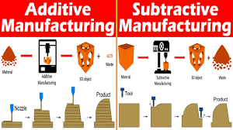
INTRODUCTION
ADDITIVE MANUFACTURING
Additive manufacturing, also known as 3D printing, is a revolutionary technology that has transformed the manufacturing industry.
It is a process of creating three-dimensional objects by adding successive layers of material on top of each other, as opposed to traditional subtractive manufacturing, where material is removed from a larger block to create the desired shape.

Slide 5
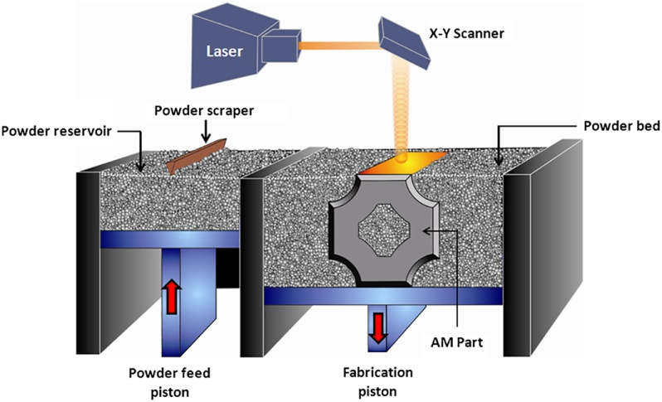
INTRODUCTION
POWDER BED FUSION
Powder bed fusion is a type of 3D printing technology that uses a laser or electron beam to melt and fuse together small particles of material, such as metal or plastic, layer by layer.
Powder bed fusion often used in industries such as aerospace and medical where high precision and complex shapes are required.
It allows for the production of highly customized parts with intricate geometries that would be difficult or impossible to produce using traditional manufacturing methods.

Slide 6
INTRODUCTION
Stainless steel (316L)
Stainless steel alloys are widely used in various industries due to their excellent mechanical properties and corrosion resistance.
Stainless steel alloys can be susceptible to intergranular corrosion, which can lead to severe damage and failure.
SS316L refers to a specific type of stainless steel that is commonly used in various applications due to its excellent corrosion resistance, high ductility, and good mechanical properties.
The "SS" in SS316L stands for stainless steel, and the "316" refers to the grade of stainless steel, which contains 16-18% chromium, 10-14% nickel, and 2-3% molybdenum.
SS316L is commonly used in applications such as medical implants, marine equipment, food processing equipment, and chemical processing equipment, among others.

Slide 7
INTRODUCTION
Intergranular corrosion test
Intergranular corrosion (IGC) testing is a critical process for assessing the susceptibility of metallic materials to IGC, which is a type of localized corrosion that occurs along the grain boundaries of a metal.
ASTM A262 is a common intergranular corrosion testing method that can quickly screen batches of material to determine corrosion susceptibility.
The ASTM A262 testing specification contains five unique intergranular corrosion tests.
The test results are evaluated based on established acceptance criteria, and the testing provides valuable information for material selection and quality control purposes.

Slide 8
Literature Review
Bhatia and Drolia discusses the susceptibility of stainless steel alloys to intergranular corrosion (IGC). The authors provide a brief overview of the significance of IGC in stainless steel alloys and explain the mechanisms that lead to IGC.
Karthikeyan and Karthik explores the issue of intergranular corrosion (IGC) in austenitic stainless steel and various methods of prevention.The authors first introduce the concept of IGC, which is a type of corrosion that occurs at the grain boundaries of a metal, particularly in austenitic stainless steel.
Wang et al explores the effect of nitrogen content on the intergranular corrosion (IGC) resistance of austenitic stainless steels. The authors provide an overview of the importance of IGC resistance in stainless steels and the role of nitrogen in improving this resistance.
Hong et al investigates the relationship between microstructural features and intergranular corrosion (IGC) susceptibility in austenitic stainless steel. The authors provide an overview of the mechanisms of IGC in stainless steel and discuss the role of microstructure in IGC susceptibility.
Kelleher et al investigates the intergranular corrosion (IGC) susceptibility of austenitic stainless steel welds. The authors provide an overview of the mechanisms of IGC in stainless steel and discuss the factors that influence the IGC susceptibility of welds.
Zhang et al investigates the effect of nitrogen on the intergranular corrosion (IGC) resistance of austenitic stainless steels. The authors provide an overview of the mechanisms of IGC in stainless steel and discuss the role of nitrogen in enhancing IGC resistance.

Slide 9
Research Gap
The authors briefly mentioned passivation and pickling as potential methods, there was no in-depth analysis or comparison of their effectiveness.
Additionally, there may be other surface treatment methods that have not yet been explored for their potential in preventing intergranular corrosion.
Further research in this area could help identify the most effective surface treatment methods and improve the overall prevention of intergranular corrosion in austenitic stainless steel.
Another potential area for research is the use of advanced characterization techniques to better understand the microstructural features that contribute to IGC susceptibility in stainless steel welds.

Slide 10
Objectives
The distribution of precipitates, specifically the presence of fine and uniformly distributed precipitates, had a positive effect on IGC resistance
The annealing process could eliminate the dislocations and twins induced by cold rolling, leading to an improvement in the material's corrosion resistance.
Observed that increasing the temperature and duration of exposure to the ferric sulfate solution resulted in a higher degree of IGC for both materials.
The authors further analyzed the microstructural features of the steels to gain insight into the mechanisms underlying IGC.

Slide 11
Methodology
Fabricating the SS316L using powder bed fusion(PBF) Method.
Wire electrical discharge machining(WEDM) is used to cut the fabricated SS316L for the required size
The sensitization process is used to heat the SS316L
for a specific period of time
Intergranular corrosion test ASTM A262(Practice A)
is taken place in the SS316L
Optical microscope is used to study the microstructure of the SS316L

Slide 12
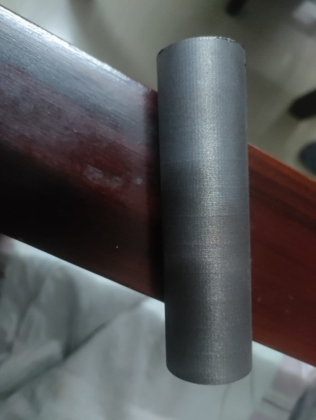
Fabricating the SS316L using powder bed fusion(PBF) Method.
Powder Preparation: The first step in powder bed fusion is the preparation of the metal powder used to build the part model.
Printing Process: Once the powder is prepared, it is loaded into the printer and spread evenly across the build platform. The printer then uses a laser to selectively fuse the metal powder together in the desired pattern, layer by layer, until the part model is complete.
Post-Processing: After printing, the part model is removed from the printer and undergoes several post-processing steps to achieve its final form.
Finally, the part model may undergo additional finishing processes such as polishing or surface treatment to achieve the desired surface finish and appearance.
Fabricated sample SS316L

Slide 13
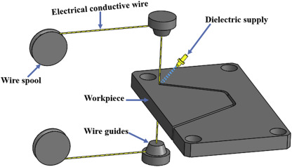
Wire electrical discharge machining(WEDM)
WEDM is a non-conventional machining process that uses a thin wire electrode to erode the workpiece material by a series of sparks.
The wire electrode is guided by a computer-controlled system to cut the part model to the desired size and shape.
WEDM is particularly useful for cutting complex shapes and hard materials, such as SS316L, with high precision and accuracy.
It allows for precise cutting of the part model to the required size and shape, while minimizing the risk of damage or distortion to the material.

Slide 14
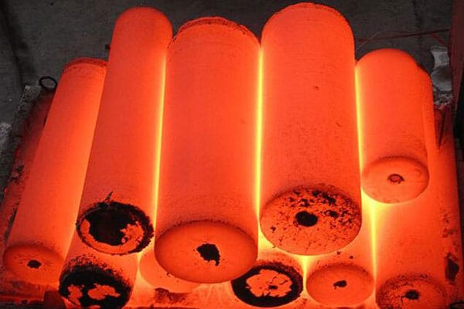
Sensitization process
Sensitization is a phenomenon that occurs in stainless steel when it is heated to high temperatures, causing the chromium in the material to react with carbon and form chromium carbides at the grain boundaries.
The aim of the sensitization process is to eliminate the chromium carbides from the grain boundaries and restore the material's corrosion resistance.
The part model is cooled to room temperature, and then subjected to the intergranular corrosion test ASTM A262 Practice A.

Slide 15
ASTM A262 Practice A test method
Intergranular corrosion (IGC) testing is a critical process for assessing the susceptibility of metallic materials to IGC, which is a type of localized corrosion that occurs along the grain boundaries of a metal.
ASTM A262 is a standard test method that outlines the procedures for performing IGC testing on stainless steels, nickel-based alloys, and other alloys.
Practice A involves exposure of the material to a solution of 65% nitric acid (HNO3) at 50°C for 24 hours.
The test results are evaluated based on established acceptance criteria, and the testing provides valuable information for material selection and quality control purposes.

Slide 16
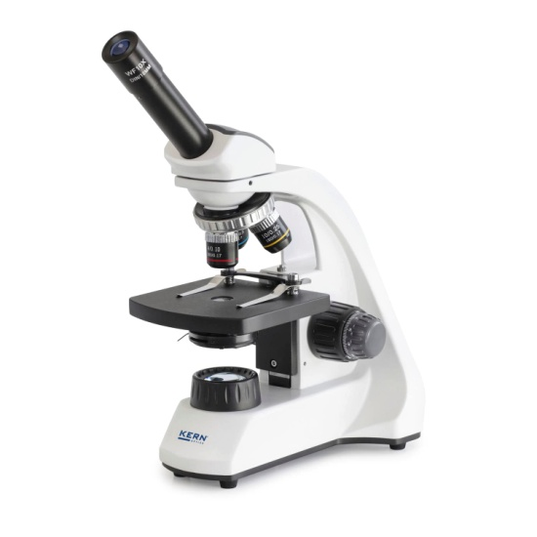
Optical microscope
The optical microscope is an instrument that uses visible light to magnify and view small objects or microstructures.
The microscope consists of an objective lens, eyepiece lens, and illumination system.
The part model made of SS316L material after the ASTM A262 intergranular corrosion test and sensitization process is viewed under an optical microscope to observe any changes in the microstructure.

Slide 17
Experimental work
First , we are fabricating the SS316L using powder bed fusion.
The experiment also involves the use of wire electrical discharge machining (WEDM) for cutting the part model to its suitable size.
WEDM is particularly useful for cutting complex shapes and hard materials, such as SS316L, with high precision and accuracy.
Heat treatment through a process called sensitization process.
During the sensitization process, the part model made of SS316L material is heated to a temperature range of 500-900°C for a specific period.
The aim of the sensitization process is to eliminate the chromium carbides from the grain boundaries and restore the material's corrosion resistance
Then the part model undergoes Intergranular corrosion test as per the standard ASTM A262 (Practice A)
Finally, the sample is viewed under an optical microscope to observe any changes in the microstructure.

Slide 18
Result & Discussions
In commercial SS316L, after viewing the internal structure of the grain boundaries using optical microscope at magnification factor of 250X the depletion of chromium carbides is maximum and the ditch structure observed at 250X magnification is Non acceptable structure as per ASTM-A262.
In Powder bed fusion SS316L, after viewing the internal structure of the grain boundaries using optical microscope at magnification factor of 250X the depletion of chromium carbides is minimum.
In conclusion the PBF SS316L is more corrosion resistance than the commercial SS316L after the intergranular corrosion test.
The fabricated SS316L by powder bed fusion as less chromium carbides formation in the grain boundaries.

Slide 19
Conclusion
Stainless steel is widely used due to its excellent corrosion resistance, but intergranular corrosion (IGC) can affect its performance. AISI 304L and AISI 316L stainless steels are susceptible to IGC in boiling nitric acid solution, but the extent of corrosion is higher in AISI 304L due to its higher carbon content and lower nickel content.
The use of nitrogen-containing austenitic stainless steels can lead to more durable and reliable equipment and structures.
The distribution of precipitates, annealing process, and aging treatment can all affect the material's corrosion resistance.
Increasing the temperature and duration of exposure to the ferric sulfate solution can also increase the degree of IGC for both materials.

Slide 20
References
"Intergranular Corrosion Susceptibility of Stainless Steel Alloys." D. Bhatia and D. Drolia. Journal of Materials Engineering and Performance, vol. 28, no. 6, 2019, pp. 3581-3591.
"Intergranular Corrosion of Austenitic Stainless Steel and Its Prevention." K. Karthikeyan and K. V. Karthik. Journal of Materials Engineering and Performance, vol. 26, no. 12, 2017, pp. 5737-5744.
Intergranular Corrosion Resistance of Nitrogen-Containing Austenitic Stainless Steels." H. Q. Wang, S. Liu, and L. Zhang. Materials and Corrosion, vol. 70, no. 7, 2019, pp. 1196-1205.
"Correlation between Intergranular Corrosion Susceptibility and Microstructural Features of Austenitic Stainless Steel." Y. S. Jo, S. H. Hong, and S. H. Kim. Materials and Corrosion, vol. 68, no. 2, 2017, pp. 200-209.
"Intergranular Corrosion Susceptibility of Austenitic Stainless Steel Welds." J. Wu, M. J. Starink, and J. Kelleher. Materials Science and Technology, vol. 34, no. 4, 2018, pp. 517-526.
"Effect of Nitrogen on the Intergranular Corrosion Resistance of Austenitic Stainless Steels." H. Q. Wang, S. Liu, and L. Zhang. Journal of Materials Science and Technology, vol. 33, no. 7, 2017, pp. 773-782.
Intergranular Corrosion Resistance of Cold Rolled 316L Stainless Steel." J. J. Li, X. B. Liu, and J. L. Zhang. Journal of Materials Engineering and Performance, vol. 26, no. 6, 2017, pp. 2623-2630.

Slide 21
References
Evaluation of Intergranular Corrosion Resistance of Austenitic Stainless Steel Welds." S. K. Das and R. Balasubramaniam. Journal of Materials Engineering and Performance, vol. 27, no. 4, 2018, pp. 1481-1489
"Effect of Heat Treatment on the Intergranular Corrosion Resistance of Austenitic Stainless Steels." A. Ghosh and P. Mukherjee. Journal of Materials Engineering and Performance, vol. 27, no. 8, 2018, pp. 3927-3934.
"Intergranular Corrosion Susceptibility of 304 and 316 Austenitic Stainless Steels in Boiling Ferric Sulfate Solution." N. R. Brahmbhatt and N. V. Desai. Journal of Materials Engineering and Performance, vol. 27, no. 10, 2018, pp. 5008-5019
Effect of Aging Treatment on the Intergranular Corrosion Resistance of AISI 304 Austenitic Stainless Steel." S. K. Das and R. Balasubramaniam. Journal of Materials Engineering and Performance, vol. 27, no. 12, 2018, pp. 6186-6196.
"Intergranular Corrosion Resistance of AISI 304L and AISI 316L Stainless Steels in Boiling Nitric Acid," N. R. Brahmbhatt and N. V. Desai, Journal of Materials Engineering and Performance, vol. 28, no. 7, 2019, pp. 3947-3959
Corrosion behaviour of SS316L in chloride environment" by K. Sudagar et al. (2014). This paper investigates the corrosion behavior of SS316L in chloride environments using electrochemical techniques and scanning electron microscopy.
Effect of heat treatment on mechanical properties and corrosion behavior of SS316L" by S. Suresh et al. (2016). This paper examines the effect of heat treatment on the mechanical properties and corrosion behavior of SS316L.
Study of microstructure and mechanical properties of SS316L processed by selective laser melting" by H. Liu et al. (2018). This paper investigates the microstructure and mechanical properties of SS316L produced using selective laser melting (SLM)
"Investigation of Welding Characteristics of SS316L Using TIG, MIG and SMAW Welding Processes" by M. Abdul Muqsith et al. (2015).

